Slide 1
Analyzing Health Equity Using Household Survey Data
Lecture 17
Redistributive Effect of Health Finance
Notes:
1. Who pays for health care? To what extent are payments toward health care related to ability to pay? Is the relationship proportional? Or is it progressive—do health care payments account for an increasing proportion of ability to pay (ATP) as the latter rises? Or, is there a regressive relationship, in the sense that payments comprise a decreasing share of ATP? The preferred relationship between health care payments and ATP will vary across individuals with their conceptions of fairness. But identification of the nature of the empirical relationship and quantification of the degree of any progressivity or regressivity is of interest, not only from a wide range of equity perspectives, but also for macroeconomic and political analyses of the health care system.

Slide 2
Contributions to health finance may redistribute disposable income
Can occur when payments compulsory and independent of utilisation
Societal (/policy) interest may stem from concern for distribution of income
Redistribution can be vertical – payments disproportionately related to ability to pay (ATP) (e.g. progressive)
But can also derive from horizontal inequity – unequal payments at equal ATP
Notes:
2
2
Contributions toward the finance of health care may redistribute disposable income. This redistribution may be intended or unintended. Even in the latter case, policy makers may be interested in the degree to which it occurs because of consequences for the distribution of goods and services other than health care and, ultimately, for welfare. Redistribution can occur when payments toward the financing of health care are compulsory and independent of utilization, most obviously when health care is partly financed from government tax revenues. If tax liabilities rise disproportionately with gross incomes, then the posttax distribution of income will be more equal than the pretax distribution. When health care payments are made voluntarily, they do not have a redistributive effect on economic welfare. Payments are made directly in return for a product—health care. It would not make sense to consider the welfare-reducing effect of the payments made while ignoring the welfare-increasing effect of the health care consumption deriving from those payments. This begs the question of the extent to which out-of-pocket payments for health care should be considered voluntary. It might be argued that the moral compulsion to purchase vital health care for a relative is no less strong than the legal compulsion to pay taxes. But in most instances, there is discretion in the purchase of health care in response to health problems.
Redistribution can be vertical and horizontal. The former occurs when payments are disproportionately related to ability to pay. The extent of vertical redistribution can be inferred from measures of progressivity discussed in the previous chapter. Horizontal redistribution occurs when persons with equal ability to pay contribute unequally to health care payments. In this chapter, we describe how the total redistributive effect of compulsory health payments can be measured and how this redistribution can be decomposed into its vertical and horizontal components.

Slide 3

Measurement of redistributive effect (RE)
Compare inequality in pre-payment incomes with inequality in post-payment incomes
Measure inequality by the Gini coefficient (G)
Then
  where G^{X} is gross of contributions to health finance and G^{X-P} is net of contributions
Notes:
One way of measuring the redistributive effect of any compulsory payment on the distribution of incomes is to compare inequality in prepayment incomes—as measured by, for instance, the Gini coefficient—with inequality in postpayment incomes (Lambert 1989). The redistributive impact can be defined as the reduction in the Gini coefficient caused by the payment.

Slide 4
Decomposition of redistributive effect
RE can be decomposed into:
  Vertical redistribution (V)
  Horizontal inequity (H)
  Reranking (R)
Reranking refers to changes in individuals’ positions in the income distribution due to differential contributions to health finance
RE = V-H-R (Aronson et al, 1994)
Vertical redistribution (progressivity) contributes positively to redistribution and is offset by horizontal inequity and reranking
To make the decomposition, one must define individuals within certain intervals of pre-payment income as ‘equals’ and subsequently group them accordingly
Notes:
1. Because there are few households in any sample with exactly the same prepayment income, one needs to artificially create groups of prepayment equals, within intervals of prepayment income, to distinguish and compute the components of RE=V-H-R. That is, H can only be measured given individuals considered to have equal incomes.

Slide 5
Vertical redistribution (V)
V is the redistribution that would arise if there were no horizontal inequity
V = G^{X}-G⁰, where G⁰ is the between groups (of equals) Gini for post-payment incomes
Then V = [g/(1-g)]K_{E}
  where g is average tax rate and
  K_{E} is the Kakwani index of payments that would arise if there were horizontal equity ; K_{E} = C⁰ – G^{X}, where C⁰ is the between-groups concentration index for payments
Redistribution generated by a given degree of progressivity (K_{E}) is ‘scaled’ by the size of the tax burden (g)
Notes:
3
It is immediately obvious that the decomposition of RE can only be done by first defining groups that are to be considered equal with respect to pre-payment incomes.
G^0 can be computed by replacing all post-payment incomes by their group mean values. Groups being defined in terms of intervals of pre-payment incomes.

Slide 6
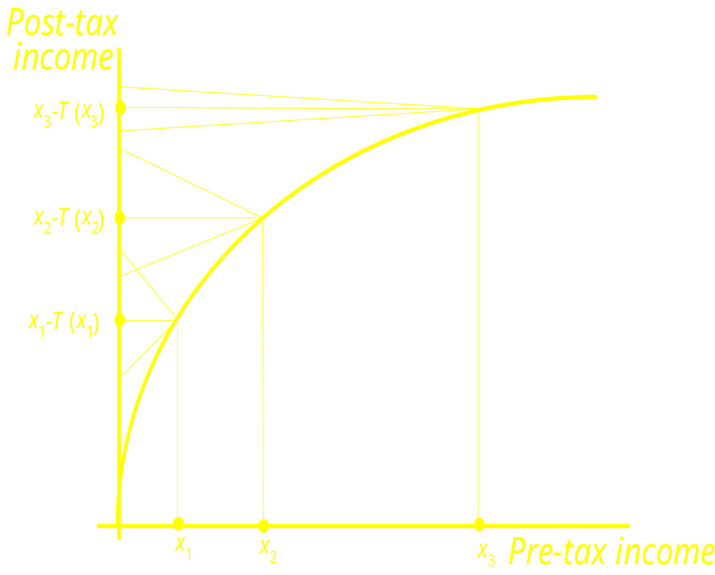
Progressive tax & differential treatment
Concavity indicates progressivity
Progressivity implies redistribution
But differential treatment increases post-tax inequality and reduces RE
RE = [g/(1-g)]K_{E} - D
  = V - D
D is the offsetting effect due to differential treatment
Notes:
4
4
Diagram illustrates case of progressive tax. Effect of progressive tax is to reduce inequality in income — i.e. there is less inequality in post-tax income than there is in pre-tax income.
Differential treatment (i.e. classical horizontal inequity) results in ‘fans’ on post-tax income axis at each level of pre-tax income. Thus, on average, people with pre-tax income equal to x₁ end up with post-tax income equal to x₁-T(x₁). But this is true only on average: in fact, some people end up with more than this; some with less.
Reranking occurs when fans overlap. This happens to some people starting out with pre-tax incomes x₁ and x₂ — i.e. some people on pre-tax income x₁ end up with a post-tax income that is larger than the post-tax income of some of the people starting with a pre-tax income equal to x₂.
Note that the fans for x₂ and x₃ do not overlap. Thus differential treatment (i.e. classical horizontal inequity) doesn’t necessarily result in reranking.
Note that with a marginal tax rate that is always less than 100% (i.e. no downward-sloping section in graph), any reranking must be due to differential treatment. So, classical horizontal inequity is a necessary condition for reranking to occur, but isn’t a sufficient condition.

Slide 7
Progressive tax with horizontal inequity (H) & reranking
Fans arise because of differential treatment (H)
Fan overlap results in reranking
H can occur without reranking — but not vice versa
Both H and reranking reduce the RE (increase post-payment inequality)
Notes:
4
4
Diagram illustrates case of progressive tax. Effect of progressive tax is to reduce inequality in income — i.e. there is less inequality in post-tax income than there is in pre-tax income.
Differential treatment (i.e. classical horizontal inequity) results in ‘fans’ on post-tax income axis at each level of pre-tax income. Thus, on average, people with pre-tax income equal to x₁ end up with post-tax income equal to x₁-T(x₁). But this is true only on average: in fact, some people end up with more than this; some with less.
Reranking occurs when fans overlap. This happens to some people starting out with pre-tax incomes x₁ and x₂ — i.e. some people on pre-tax income x₁ end up with a post-tax income that is larger than the post-tax income of some of the people starting with a pre-tax income equal to x₂.
Note that the fans for x₂ and x₃ do not overlap. Thus differential treatment (i.e. classical horizontal inequity) doesn’t necessarily result in reranking.
Note that with a marginal tax rate that is always less than 100% (i.e. no downward-sloping section in graph), any reranking must be due to differential treatment. So, classical horizontal inequity is a necessary condition for reranking to occur, but isn’t a sufficient condition.

Slide 8
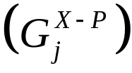
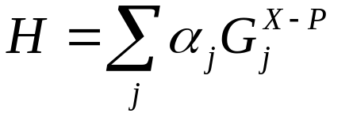
Measurement of Horizontal Inequity (H)
H is weighted sum of group (j) specific post-payment Gini coefficients
  where weights are the product of the group’s population share and its post-payment income share
H must be non-negative – it increases post-payment inequality and reduces redistributive effect (see previous dgms.)
Notes:
1. Note that because the Gini coefficient for each group of prepayment equals is nonnegative, H is also nonnegative. Because it is subtracted in equation 17.2, horizontal inequity H can only reduce redistribution, not increase it. This simply implies that any horizontal inequity will always make a postpayment distribution of incomes more unequal than it would have been in its absence.

Slide 9
Measurement of reranking
R = G^{X-P}-C^{X-P},
  where C^{X-P} is a concentration index for post-payment incomes obtained by ranking first by pre-payment income and then, within each group of pre-payment ‘equals’, by post-payment income
R cannot be negative since the Lorenz curve for post-payment income cannot lie below the concentration curve
R is zero if the rankings by pre and post payment incomes coincide – there is no reranking
So, reranking increases inequality and reduces redistributive effect

Slide 10
Feasibility of the decomposition
Decomposition of RE into V, H and R requires defining intervals of pre-payment income as ‘equals’
The relative magnitudes of H and R depend on the intervals chosen, which are somewhat arbitrary
So magnitude of V relative to RE (H+R) is most interesting aspect of decomposition
Notes:
1. Practical execution of this decomposition requires an arbitrary choice of income intervals to define “equals.” Although this choice will not affect the total H+R, it will affect the relative magnitudes of H and R. In general, the larger are the income intervals, the greater will be the estimate of horizontal inequity and the smaller will be the estimate of reranking (Aronson, Johnson, and Lambert 1994). That makes the distinction between H and R rather uninteresting in applications.[1] More interesting is the quantification of the vertical redistribution V, both in absolute magnitude and relative to the total redistributive effect, and its separation into the average rate and progressivity effects.
[1] See Duclos, Jalbert, and Araar (2003) for an alternative approach that avoids this limitation.

Slide 11
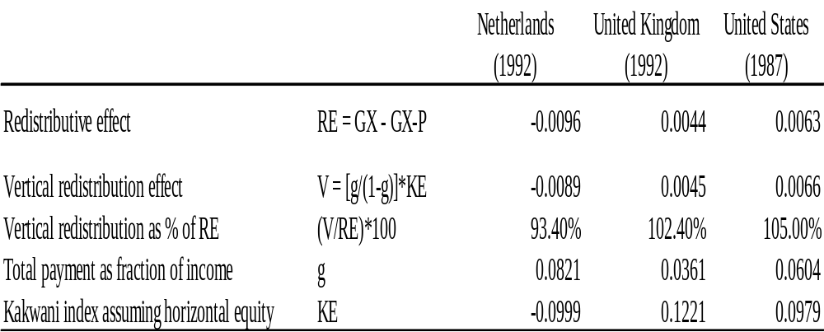
Redistributive Effect of Public Finance of Health Care in the Netherlands, UK & US
Notes:
To illustrate the redistributive effect of health finance and its decomposition, we present results for three countries—the Netherlands, the United Kingdom, and the United States—taken from van Doorslaer et al. (1999). For each country, we show the redistributive effect of compulsory payments toward publicly financed health care. Public finance predominates in the finance of health care in both the Netherlands and the United Kingdom, but the source differs. The Netherlands relies mainly on social insurance, whereas most finance in the United Kingdom comes from general taxation. Although the majority of health care finance is private in the United States, there is a substantial contribution from public funds, with two-thirds of this from general taxation.
The figures in the first row of the table indicate that public finance of health care brings about redistribution from rich to poor in the United Kingdom and the United States but from poor to rich in the Netherlands. In both the United Kingdom and the United States, vertical redistribution is very large in comparison with the total redistribution. If there were no horizontal inequity, redistribution from rich to poor would be only 2.4 percent and 5 percent greater than its actual magnitude in the United Kingdom and United States, respectively. In the Netherlands, vertical redistribution is from poor to rich, and horizontal inequity and reranking adds a further 6.6 percent of the redistribution in that direction. In absolute value, the redistribution is largest in the Netherlands because public payments for health care are larger relative to income—8.2 percent of income, compared with only 3.6 percent in the United Kingdom and 6 percent in the United States. It is interesting that the United States spends relatively more public dollars on health care than does the United Kingdom, despite the United Kingdom being a predominantly publicly funded system. This difference in the scale of public spending is responsible for the greater redistributive effect in the United States. Public finance is more progressive in the United Kingdom, indicated by the Kakwani index, but there is less of it.

Slide 12
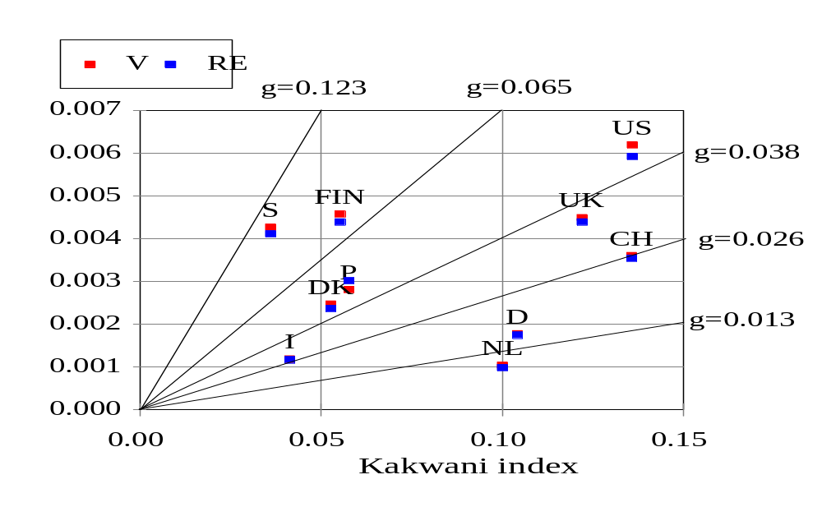
RE from all taxes going into health care
Notes:
Van Doorslaer et al (1999) Journal of Health Economics
In most countries there is little difference between the total redistributive effect and vertical redistribution, indicating little horizontal inequity and/or reranking. This is because we focus here only on taxes.
The graph does show that both the degree of progressivity, as measured by the Kakwani, and the average tax rate contribute to the magnitude of the redistributive effect. For example, progressivity of taxes is similar in the US and Switzerland, but the RE is larger in the US due to a higher tax burden.

Slide 13
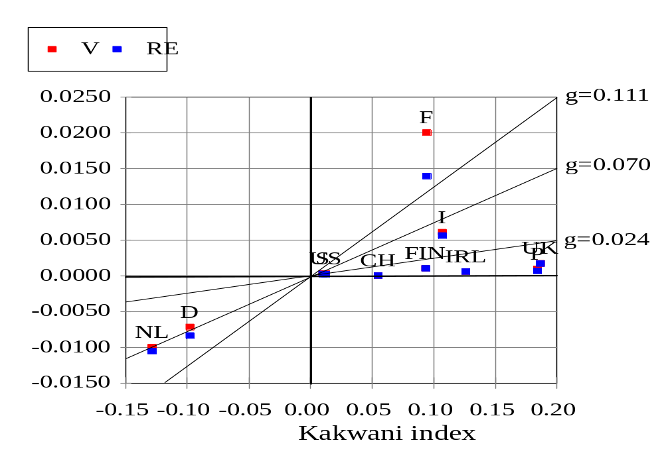
RE of all social health insurance
Notes:
1. Here we see a larger divergence between RE and V, for example in France, indicating greater horizontal inequity and reranking from social insurance contributions.

